Slide 1


ELEC 5620M
Embedded System Design
Mini-project
Name : Weiming Xu
Student ID: 201562426

Slide 2

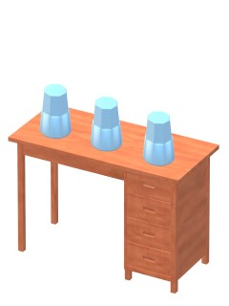

What I have done
Name: Find the Red ball
A Video game

Slide 3
What I have used
Hardware
LT24 LCD
Seven-segment Display
Audio
Key Buttons
Red LED
Software
Eclipse for DS-5

Slide 4
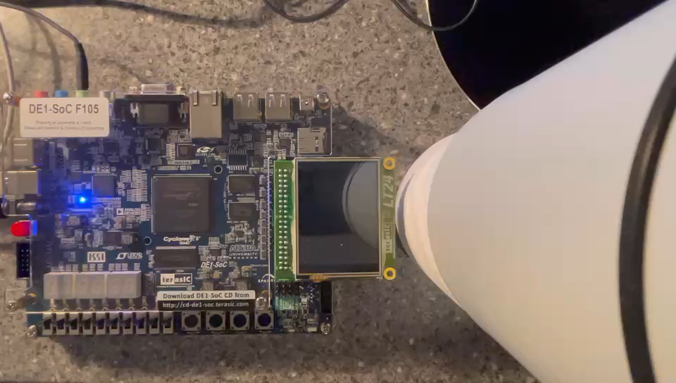
How the game works

Slide 5
Design a game
What I have learned
Picture Design
Logic Design
Hardware Test
Debug
Code issues
New
Old
Key Buttons
Red LED
Seven-Segment Display
LT24 LCD
Audio

Slide 6
Thank You!

